Slide 1
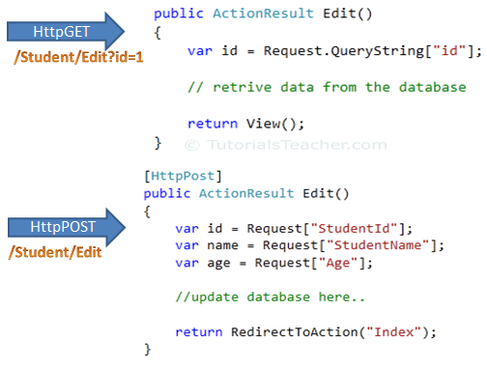
Model Binding
To understand the model binding in MVC, first let's see how you can get the http request values in the action method using traditional ASP.NET style. The following figure shows how you can get the values from HttpGET and HttpPOST request by using the Request object directly in the action method.

Slide 2
Model Binding
in the above figure, we use the Request.QueryString and Request (Request.Form) object to get the value from HttpGet and HttpPOST request. Accessing request values using the Request object is a cumbersome and time wasting activity.
With model binding, MVC framework converts the http request values (from query string or form collection) to action method parameters. These parameters can be of primitive type or complex type.

Slide 3
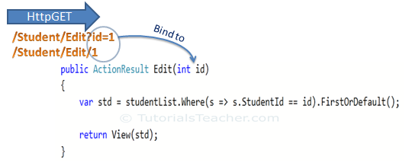
Model Binding
Binding to Primitive type
HttpGET request embeds data into a query string. MVC framework automatically converts a query string to the action method parameters. For example, the query string "id" in the following GET request would automatically be mapped to the id parameter of the Edit() action method.
You can also have multiple parameters in the action method with different data types. Query string values will be converted into paramters based on matching name.
For example, http://localhost/Student/Edit?id=1&name=John would map to id and name parameter of the following Edit action method.
public ActionResult Edit(int id, string name) { // do something here return View(); }

Slide 4
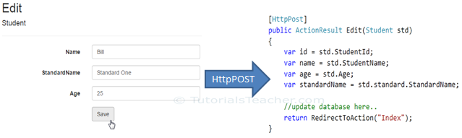
Model Binding
Binding to Complex type
Model binding also works on complex types. Model binding in MVC framework automatically converts form field data of HttpPOST request to the properties of a complex type parameter of an action method.
MVC framework will automatically maps Form collection values to Student type parameter when the form submits http POST request to Edit action method

Slide 5
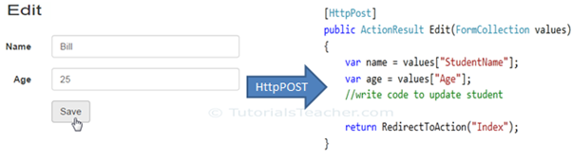
Model Binding
FormCollection
You can also include FormCollection type parameter in the action method instead of complex type, to retrieve all the values from view form fields as shown below.

Slide 6
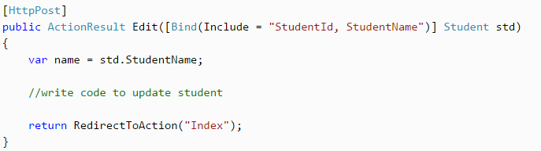
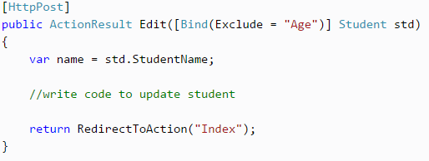
Model Binding
Bind Attribute
ASP.NET MVC View that accepts user input and posts those inputs to a server we have the option to use the built-in Model-binding features to provide more control and security, we can restrict the properties that are allowed to be bound automatically.
ASP.NET MVC framework also enables you to specify which properties of a model class you want to bind. The [Bind] attribute will let you specify the exact properties a model binder should include or exclude in binding.

Slide 7
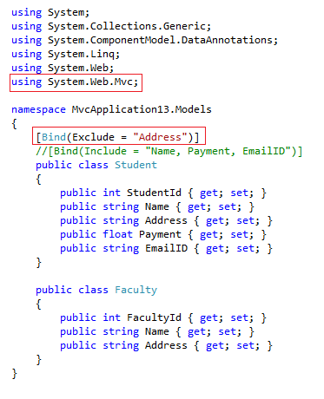
Model Binding

